Slide 1


VISVESVARAYA TECHNOLOGICAL UNIVERSITY, BELAGAVI
“AUTOMATION OF LIGHTING SYSTEM USING
RASPBERRY PI AND IOT”
Submitted by
Apoorva C 4YG18CS001
Internal Guide External Guide
Dr. Myna A N Mr. Dhananjay B P
HOD of CS&E Dept. Loginware softtec pvt. Ltd,
NCE, Hassan Hassan
DEPARTMENT OF COMPUTER SCIENCE AND ENGINEERING
NAVKIS COLLEGE OF ENGINEERING, HASSAN
2021-22

Slide 2
CONTENTS
1. Company profile
2. About the company
3.Task performed
Introduction
Software and Hardware Components
Implementation
Output
4. Conclusion

Slide 3

COMPANY PROFILE
    LOGINWARE SOFTTEC PRIVATE LIMITED, Hassan
    IT was established in the year 2016
    Vision : To become a leading company ,thinking beyond possibilities by introducing innovative ideas.
    Mission : motivate, inspire and empower each other to do things
    Services :In-depth knowledge of various technology areas enables us to provide end to end solution and services.

Slide 4
ABOUT THE COMPANY
They have planned to do Research and Development in order to come with their set of products to the market.
The Interns will be trained thoroughly in the following areas:
Seminars and workshops
Internship program
Project Guidance
Certification Oriented Training Programs

Slide 5
TASK PERFORMED
AUTOMATION OF LIGHTING SYSTEM USING RASPBERRY PI AND IOT
Introduction
The operation of lights through the voice controlled home automation system by giving voice commands as an input to the system for user to turn ON and turn OFF the lights at home.
The system mainly uses the Raspberry pi module, which is an important component for smart light system implementation.
Raspberry pi module keeps all electrical home appliances connected through a single interface for complete smart home system automation.

Slide 6
Introduction CONT…
The smart light system has a special feature that when the light gets turned ON or turned OFF will be ensured to the user through an audio output by the user.
The main working of a voice-automated system depends on the voice recognition of the voice given by the user as an input
The Smart home systems, which uses laptop ,GSM, Bluetooth, Smartphones and many more for network communication.

Slide 7
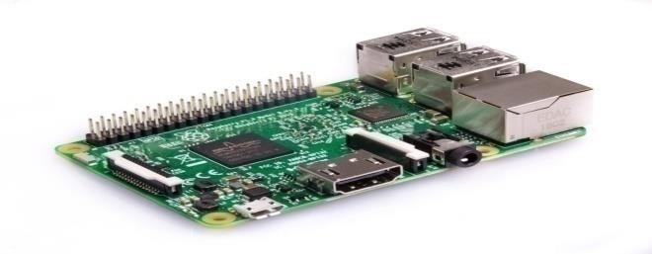

Software and Hardware components
Raspberry pi
Raspberry pi uses a Debian based computer operating system
Fig 1:Raspberry pi board
VNC
Virtual Network Computing (VNC) is a graphical desktop-sharing system that uses the Remote Frame Buffer protocol (RFB) to remotely control another computer.
Fig 2: VNC

Slide 8
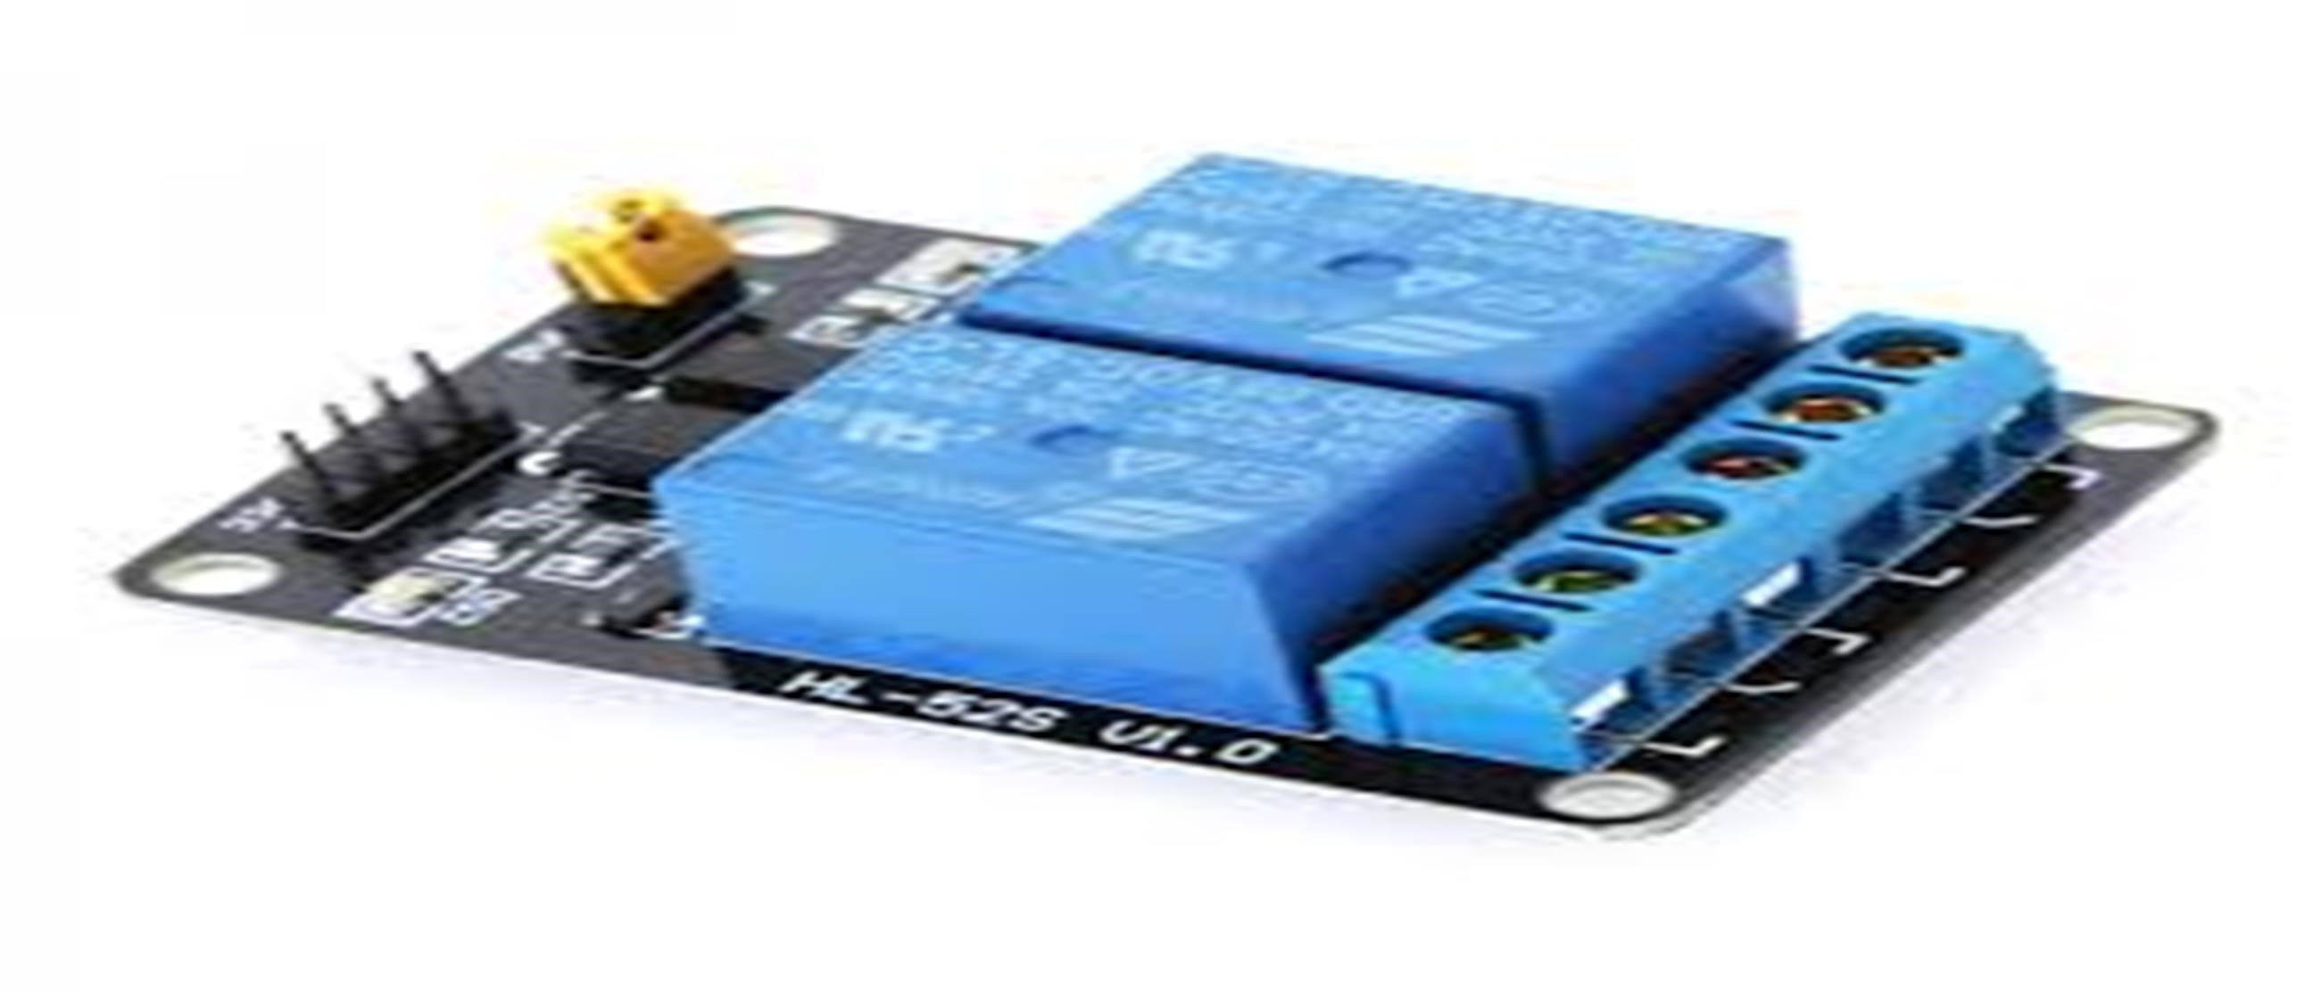
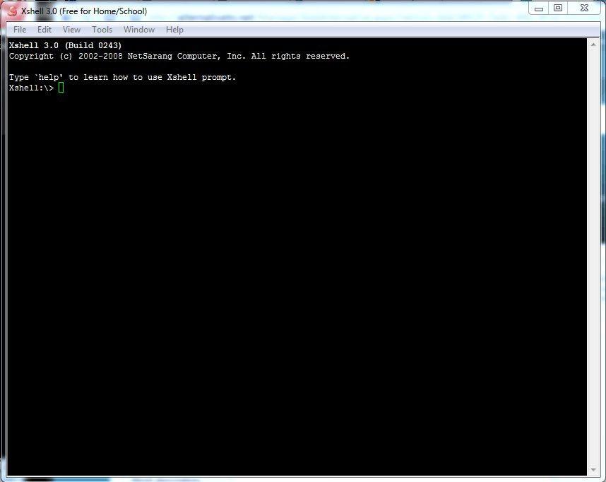
Relay board
Relays control one electrical circuit by opening and closing contact in another circuit.
Fig 3: Relay board
Xshell
Xshell is an open source terminal emulator , Serial console and network file transfer application.
Fig 4: Xshell terminal

Slide 9
IMPLEMENTATION
The Implementation of system works with a certain set of connections.
Algorithm
The algorithm for hardware connections :
Step1 : Connect raspberry pi to the router through Ethernet Cable.
Step 2 : Connect the USB mic to one of the four USB ports.
Step 3 : Connect the speaker to the audio port
Step 4 : Further connect the relay board to the Raspberry pi through the pins
Step 5 : Connect the bulbs along with 220v power supply to the relay board
Step 6 : Finally turn on the raspberry pi and router then connect it to the system through wi-fi

Slide 10
CONT…
The algorithm , which is designed for operation of Raspberry Pi
Step 1 : Open the XShell.
Step 2 : Obtain the associated IP address of the Raspberry pi Component through advanced IP scanner
Step 3 : Enter the Internet Protocol(IP) address of the Raspberry pi component in the Xshell screen as input
Step 4 : Xshell terminal will be opened. Input the user name and password of the Raspberry pi component
Step 5 : Run the file name.py in the terminal with the command :
Python file name.py

Slide 11
CONT…
Step 6 : Open another Xshell terminal. Repeat the same steps from 1 to 5. Run the speech file.py with the command: python speech file.py
Step 7: Give the voice command through USB mic.
Step 8 :Speech is converted to text through Google API
Step 9:Appropriate signal will be sent to the relay board through Raspberry pi and blub will get operated

Slide 12
CONT….
When the file name.py runs successfully, the relay board will be activated.
when the speech file.py runs successfully Google voice API will be ready to accept the voice commands.
Following voice commands are used :
Turn on the light
Turn off the light

Slide 13
CONT…
The given commands will be detected through Raspberry pi voice recognition
The voice command is then converted to text through Google voice API.
Then compared with the specified commands and the corresponding actions takes place as the result.
When the speech file.py program has been successfully executed, system will be ready to accept the voice commands

Slide 14
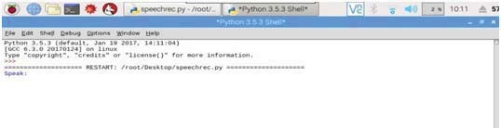
CONT…
The input voice command will be given and the given voice command will be displayed on the screen.
Fig 5: Accepting Voice input

Slide 15

OUTPUT:
Resuslt1:
The input screen accepts the voice command to turn on the light.
Fig 6 : output when the lights are turned ON

Slide 16

CONT…
Result 2:
The input screen accepts the voice command to turn off the light.
Fig 7:Output when the lights are turned off

Slide 17
CONCLUSION
The internship program was a great opportunity for me to interact with several sensor and operate with it.
I have experienced that , It is important that education is the objective but we should also be aware of the industrial aspects and practical aspect of the topic we study.
The smart home system has been successfully developed which can control lighting appliances in the house.
The smart home application program is quite satisfactory and the response received from the community, in general, is encouraging.

Slide 18
THANK YOU

